Slide 1

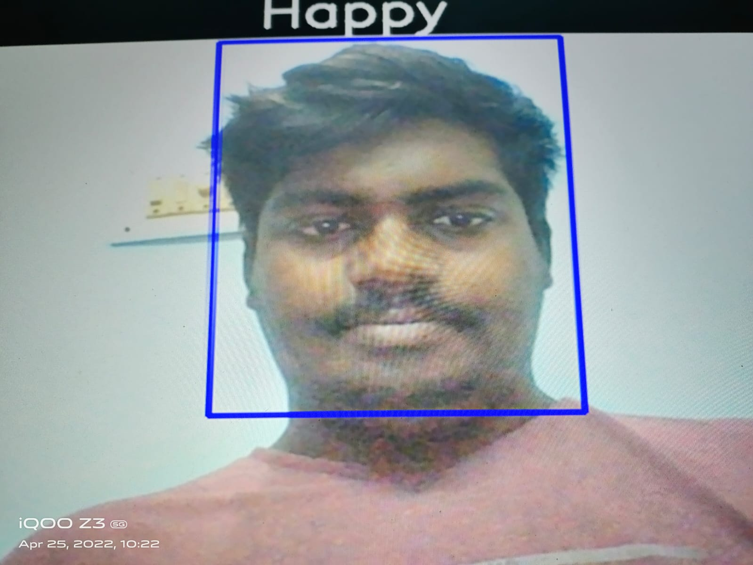

“DETECTING OF EXPRESSION AND EMOTION OF FACE USING FED ALGORITHM ALONG WITH MLP CLASSIFIER”
Department of Computer Science & Engineering
School of Computing
1156CS701 – MAJOR PROJECT
WINTER SEMESTER 21-22
ABSTRACT
INTRODUCTION
RESULTS
STANDARDS AND POLICIES
Facial affect analysis is an active field of research that aims at automatically estimating the emotions of a person in order to provide new types human–computer interaction.
However there has typically been a gap between the state of the art in psychology and what is done in computer vision.
The current approaches primarily focus on facial investigation keeping background intact and hence built up a lot of unnecessary and misleading features that confuse CNN training process. The proposed project aims for expressional examination and to characterize the given image into these five essential emotion classes, which are displeasure/anger, sad/unhappy, smiling/happy, feared, and surprised/astonished
Facial affect analysis is an active field of research that aims at automatically estimating the emotions of a person in order to provide new types human–computer interaction.
However there has typically been a gap between the state of the art in psychology and what is done in computer vision.
The current approaches primarily focus on facial investigation keeping background intact and hence built up a lot of unnecessary and misleading features that confuse CNN training process.
The proposed project aims for expressional examination and to characterize the given image into these five essential emotion classes, which are displeasure/anger, sad/unhappy, smiling/happy, feared, and surprised/astonished.
Click here to insert your Results text. Type it in or copy and paste from your Word document or other source.
Speaking of Results, yours will look better if you remember to run a spell-check on your poster! After you’ve added your content click on Review, Spelling, or press F7.
To change the font style of this text box: Click on the border once to highlight the entire text box, then select a different font or font size that suits you. This text is Calibri 24pt and is easily read up to 4 feet away on a 24x48 poster, up to 6 feet away on a 36x72 poster, and up to 8 feet away on a 48x96 poster.
Zoom out to 100% (for 24x48), 150% (for 36x72), or 200% (for 48x96) to preview what this will look like on your printed poster.
testing is used to ensure that each modular component of the project is working.
The smallest unit of the software design is the subject of testing.
The mentioned project underwent a progressive examination of testing.
Py-cham , juypter notebook , cmd,…
Table 1. Label in 20pt Calibri.
CONCLUSIONS
TEAM MEMBER DETAILS
METHODOLOGIES
Figure 1.mlp output.
Figure 2. anger
<Student 1. vtu 13217/YELURU VAIBHAV>
<Student 2 .vtu 11208/G. Sai prakesh >
<Student 3 .vtu 12541/
P. Shashank>
<Student 1. 9603496959>
<Student 2. +91 6301 729 973>
<Student 3. +91 98497 74935>
<Student 1. vtu13217@veltech.edu.in>
<Student 2. Mail ID:vtu11208@veltech.edu.in>
<Student 3. Mail ID:vtu12541@veltech.edu.in>
This the first step of image processing. It must be done on digitized images in order to minimize noise and improve the quality of the image. Face images are usually affected by background variations, such as illumination, head pose, and face patterns linked to identity bias
The data is cleaned and pre-processed at this stage, where missing and null value records are dropped. Human features are very sensitive to texture and skin tone, and most of the selected features are located around the meaningful areas for recognition, such as eyebrows, nose, cheekbones, and jaw-line. Automated valence or arousal estimation of the human face involves detecting, tracking, and normalizing the face in an image sequence. after the face and eyes are detected, the facial image can be normalized as a fixed-size image using the localized eye positions.
In this project, we investigated an MLP-based approach to facial affect analysis in naturalistic conditions with an unprecedented level of accuracy.
We confirmed the importance of facial geometric information for this task, information typically encoded by the location of fiducial landmarks on the face.
We then highlighted the importance of the attention mechanism to focus on the most relevant part of the image for the target emotion estimation task
The proposed system has shown excellent performance in the face recognition systems with a high accuracy rate and a much higher speed up rate as compared to the previously used state-of-the-art methods.
It also shows promising performance and higher estimation rates than the existing models for emotion detection and classification
ACKNOWLEDGEMENT
Project Supervisor Dr. C. Chandru Vignesh /Associate professor
Project supervisor Contact No: +91 99525 20798
Project supervisor Mail ID: drcchandruvignesh@veltech.edu.in

